Slide 1
Public transport in Pecs

Slide 2
Hol tudok venni buszjegyet illetve bérletet? Where can I buy bus ticket or pass?
Ticket and pass offices You can buy busticket on the bus or in ticket offices. Constant ticket offices:Temporary ticket offices Uránváros bus station From 29 every month to 7 the next month: Workdays: 7.00–18.00 Days off: 7.00–12.00 Kertváros, coach station From 29 every month to 7 the next month: Workdays: 7.00–18.00 Days off: 7.00–12.00 LAPKER TICKET SELLING PLACES TICKET DISTRIBUTORS Post offices Ticket selling post offices
A bérletpénztárak nyitva tartásáról az alábbi linken tájékozódhat: http://mobilitas.biokom.hu/ertekesites

Slide 3
Tickets
one ride ticket in advance (not valid on nightlines) 300 HUF
On board ticket (at driver)400 HUF
block of 10 tickets (not valid on nightlines)2 800 HUF
24-hours ticket 1 050 HUF
72-hours ticket 2 700 HUF
7-days ticket 3 170 HUF
Passes
Adult passes
monthly pass 7 055 HUF
30-days pass 7 055 HUF
half-month-pass 4 735 HUF
quarterly pass 20 180 HUF
For students and pensioners
monthly pass 3 475 HUF
quarterly pass 10 000 HUF
Other prices
general pass ID 250 HUF
handling fee by replacing a damaged 24-hours, 72-hours, 7‑days ticket or any pass 250 HUF
traveling with dog 1 ticket

Slide 4
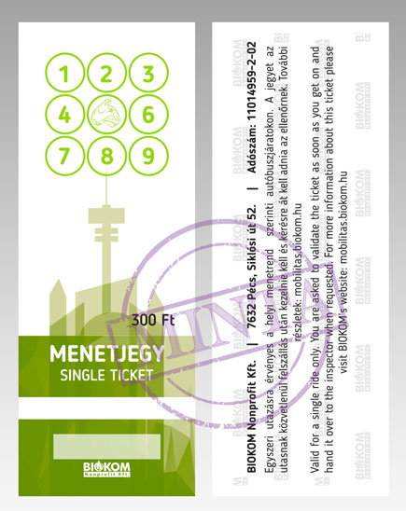
Bus ticket –Single ticket THE DAILY TICKET is valid from 00.00 to 24.00 on the given day and on the full length of all the routes for an unlimited number of journeys.

Slide 5
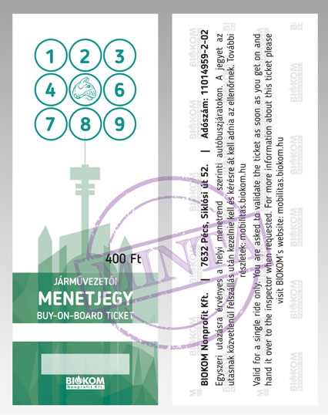
Bus ticket- buy on board ticket

Slide 6
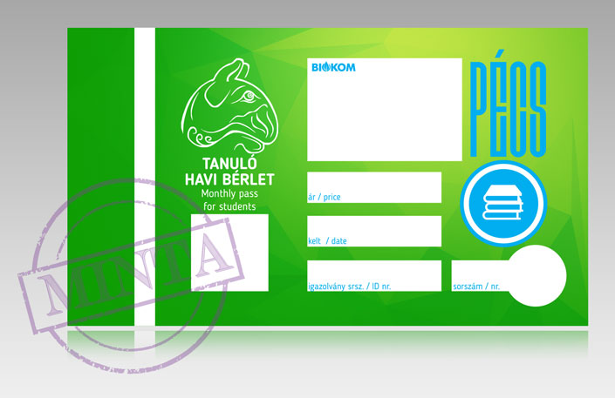
Monthly student pass MONTHLY AND QUARTERLY PASSES are valid from 00.00 the first day of the month or quarter until 24.00 the 5th day following the end of the given period.

Slide 7

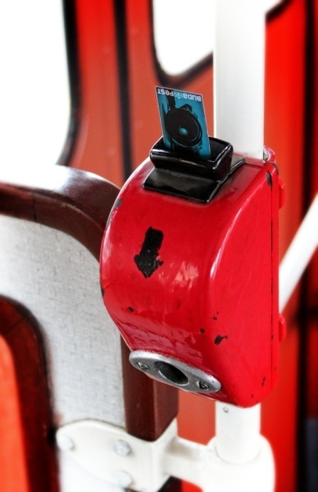
III. Használat
A busz első ajtajánál érvényesíteni kell a buszjegyet illetve fel kell mutatni a bérletet a sofőrnek
III. Use
At the first door of bus you should valid your bus ticket or you should show your monthly pass to the bus driver.
Bus Ticket →
the ticket must be put into the device until it clicks and pull towards you
Numbers

Slide 8
Please do not forget to valid your ticket or show your pass because the conductor will fine you .
If you lost your ticket or pass you should buy another one.

Slide 9
Penalty fares
Traveling without a valid ticket, pass or document; traveling with dog without a valid ticket:
paying on the spot 10 000 HUF
paying in 7 days 15 000 HUF
paying in 30 days 20 000 HUF
paying after 30 days 30 000 HUF
Carrying az object other than a luggage*; making vehicle dirty; damage vehicle:
paying on the spot10 000 HUF
paying in 7 days15 000 HUF
paying in 30 days20 000 HUF
paying after 30 days30 000 HUF

Slide 10
If made vehicle dirty: price for cleaning and disinfecting in addition.
* luggage: max. 2 pcs per person: max. 40×50×50 cm or 20×20×200 cm object
Using a faked ticket, pass or travleing document; using an incorrect discount:
paying on the spot 20 000 HUF
paying in 7 days 25 000 HUF
paying in 30 days 30 000 HUF
paying after 30 days 50 000 HUF
Showing a valid pass later or after completing the ID number on it:
paying in 7 days 1 000 HUF
You are asked to show these documents and pay this fine in our customer service. After 7 days original penalty fines apply!
Important!
Prices are in Hungarian Forints and include 21,26% VAT.

Slide 11
